Slide 1
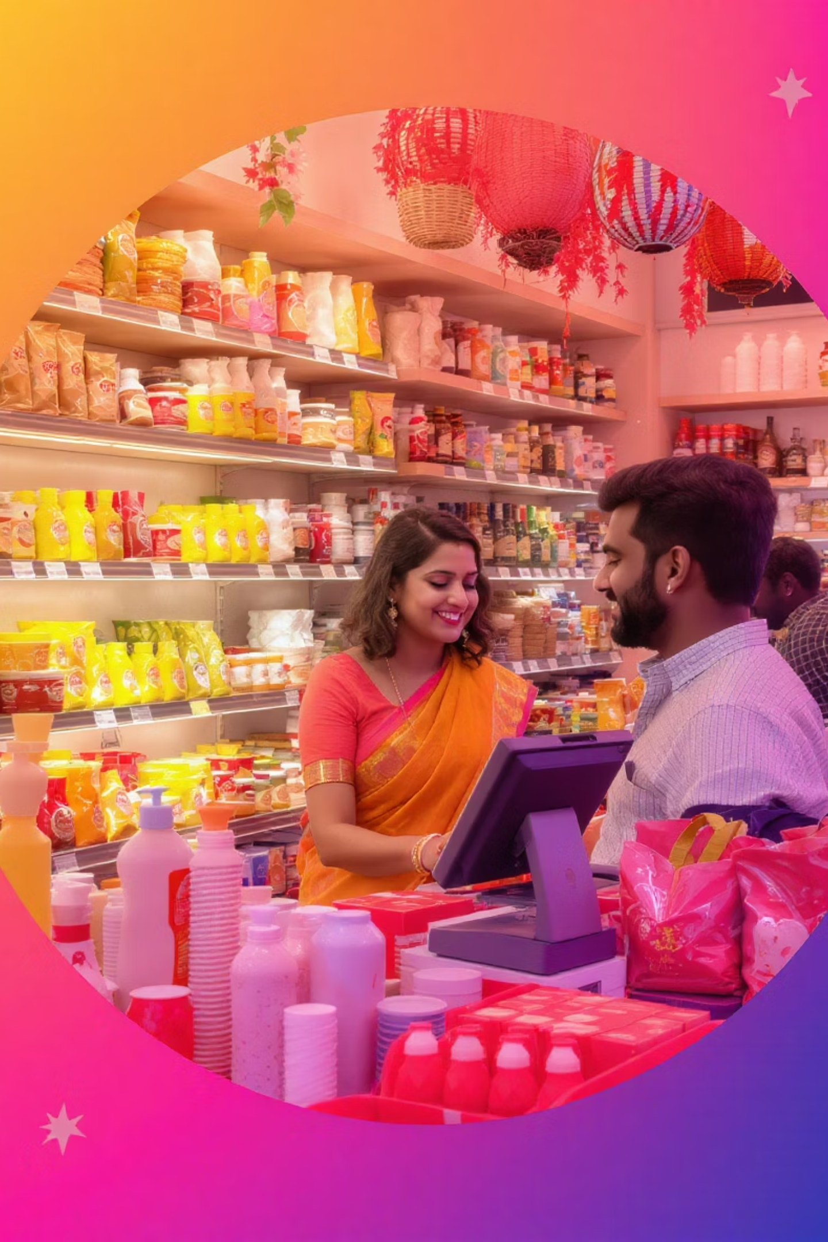

Transform Your Store with ANKAR POS
Smart Billing. Smarter Inventory. Designed for Indian Retailers.
by Rajkumar Ankar

Slide 2

The Hidden Cost of Manual Retail Management
1
Lost Customers
Slow billing creates long queues. Customers leave frustrated.
2
No Growth Clarity
Without sales reports, you can't track business performance.
3
Inventory Problems
Manual tracking leads to wastage or shortages.
4
Financial Risks
Cash mismanagement causes losses with no audit trail.

Slide 3
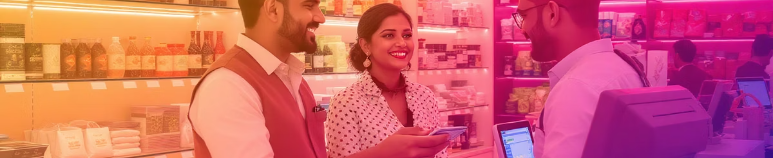




Top Reasons Indian Stores Choose POS Systems
Speedy Billing
Live Tracking
Reduce errors and serve customers faster.
Monitor sales and profits in real-time.
Stock Alerts
Customer Data
Get notified when inventory runs low.
Build loyalty through repeat sales.

Slide 4
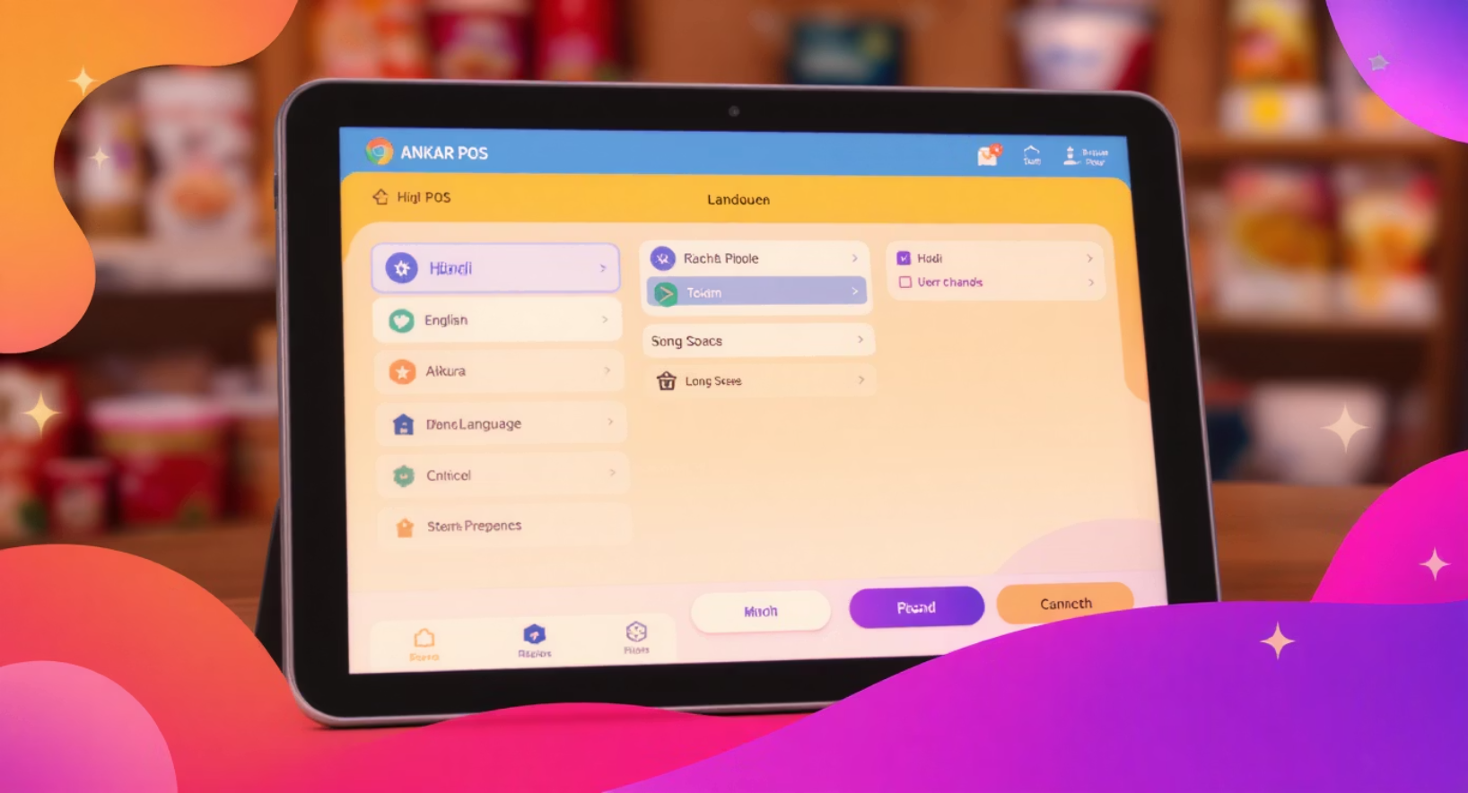
Built for India. Made for You.
1
Bilingual Interface
Use in Hindi or English. Your choice.
2
Works Offline
No internet? No problem. Keep billing.
3
Voice Commands
Simply say "Add 2 Colas" to update cart.
4
GST Ready
Compliant invoices and easy tax filing.

Slide 5
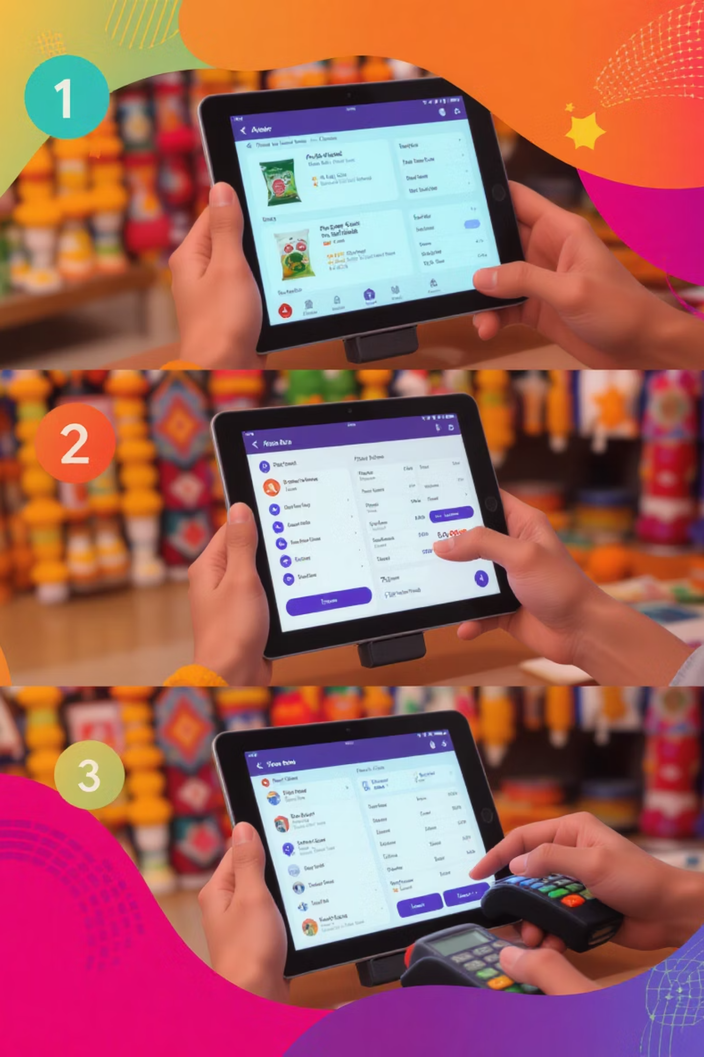
ANKAR POS in Action
Add Products
Scan barcodes, use voice commands, or enter manually.
Process Sale
Smart cart calculates discounts automatically.
Track Performance
View daily, weekly, or monthly reports instantly.
Manage Inventory
Receive alerts when stock runs low.

Slide 6





Powerful POS at a Price You Can Afford
One-Time Setup
Free Training
Low-cost initial investment. No recurring fees.
We'll teach your staff how to use it.
Optional Backup
Ongoing Support
Cloud storage keeps your data safe.
Lifetime updates and one year of support included.

Slide 7








Perfect Fit For Your Business
Kirana Shops
Stationery Stores
Streamline daily sales and inventory management.
Track diverse product categories with ease.
Medical Stores
Gift Shops
Keep track of expiry dates and critical stock.
Manage seasonal inventory and special offers.

Slide 8

Ready to Level Up Your Store?
"I didn't know I needed a POS until ANKAR showed me how much time I was wasting." — Ravi, Kirana Store Owner
Contact Us Today
Rajkumar Ankar
"Now I get daily profit reports on my phone!" — Priya, Gift Shop Owner
📞 +91 8686686850
📧 info@ankarinnovations.com
🌐 www.ankarinnovations.com

